Slide 1
GEO-AI Challenge for Cropland Mapping

Slide 2
Background
Timely, accurate crop maps are vital for numerous agricultural applications.
Limitations of Existing Products: Lack annual updates, reducing usefulness for monitoring changes.
New Opportunities: High-resolution open data (e.g. Sentinel 2) and machine learning models enable scalable modeling of cropland extent.

Slide 3
Methodology and WorkFlow
Crop Season identification using NDVI Temporal Profile
Sentinel 2 Data Processing - Cloud Masking/Compositing
Vegetation Indices generation
Model Development - HyperParameter Tuning and Classification Accuracy
Crop Extent generation

Slide 4
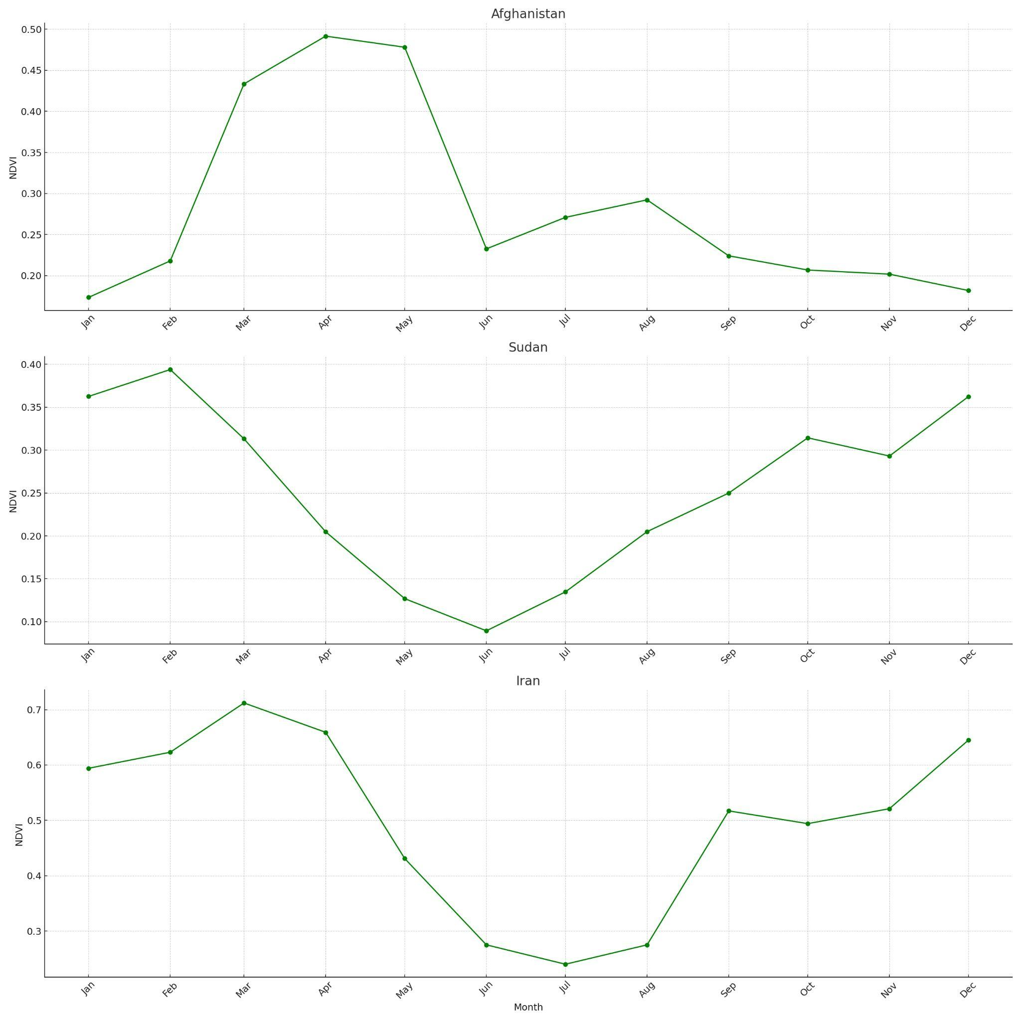
Crop Season from NDVI Profile

Slide 5
Sentinel- 2 Data Processing
Cloud Masking was done using the Cloud Probability dataset.
All pixels with a cloud probability of 50 or above were masked out.
The value of 50 was chosen to ensure a good balance between quality and quantity for the analysis.

Slide 6
Vegetation Indices
A wide variety of vegetation Indices were generated for each composite of the crop season to establish contrast between crop and non crop pixels
Following Indices shortlisted
NDVI, NDRE, ARVI, RVI, SCI, NDMI, GNDVI, BSI

Slide 7
Model Development
It is an iterative process in which many models were derived, evaluated, and tested until achieving the best performance in terms of accuracy results.
Typically focus on model creation, experimentation, and evaluation.

Slide 8
Feature Engineering:
Selecting a Feature Based on EDA, visualization, and Model performance metrics
Algorithm:
For a classification approach, a supervised ML model was used to train & evaluate.
Hyperparameter Optimization:
It is prioritized on Model-Centric approach which good model configuration ia arrived at, on the basis of Model Evaluation and Performance Metrics.
Dataset Splitting:
Split of the Dataset into Training and Validation while maintaining a balanced class.
Performance Metrics:
To give feedback and observe the model performance, a defined cost objective helps quantification of model performance.
Model Training and Evaluation:
Ensure the model does not memorize the data, but learns enough from the given training dataset. Moreover, cross-validation improves the generality of a model, by splitting into k-folds.

Slide 9
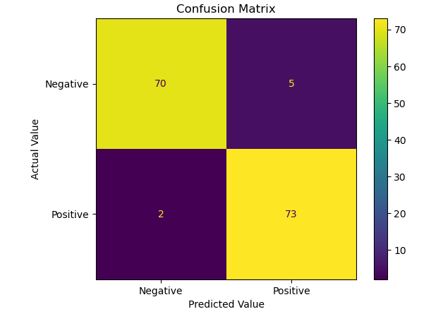
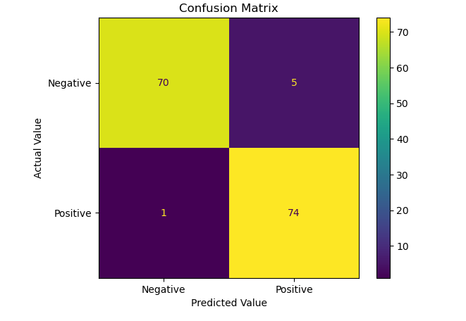
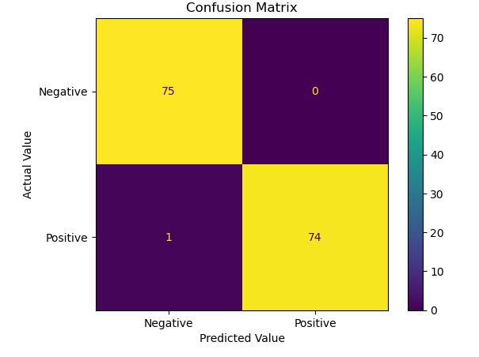

Classification Accuracy
Afghanistan
Iran
Sudan

Slide 10
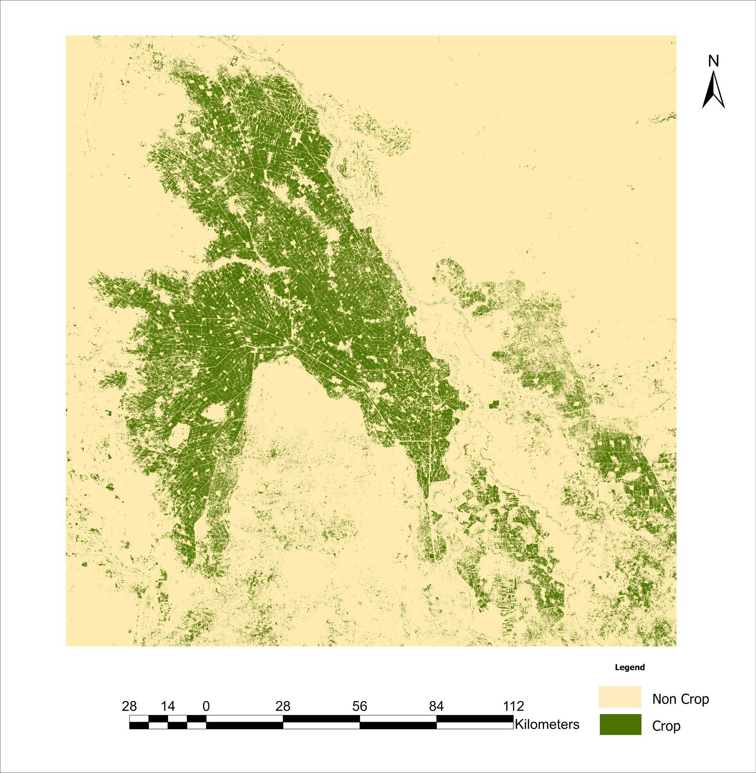
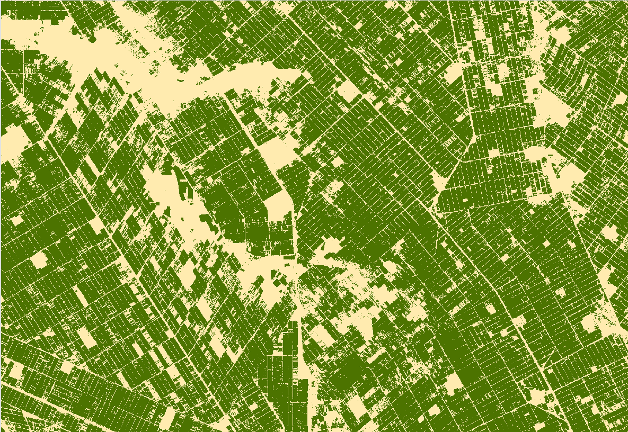
Spatial Extent - Sudan

Slide 11
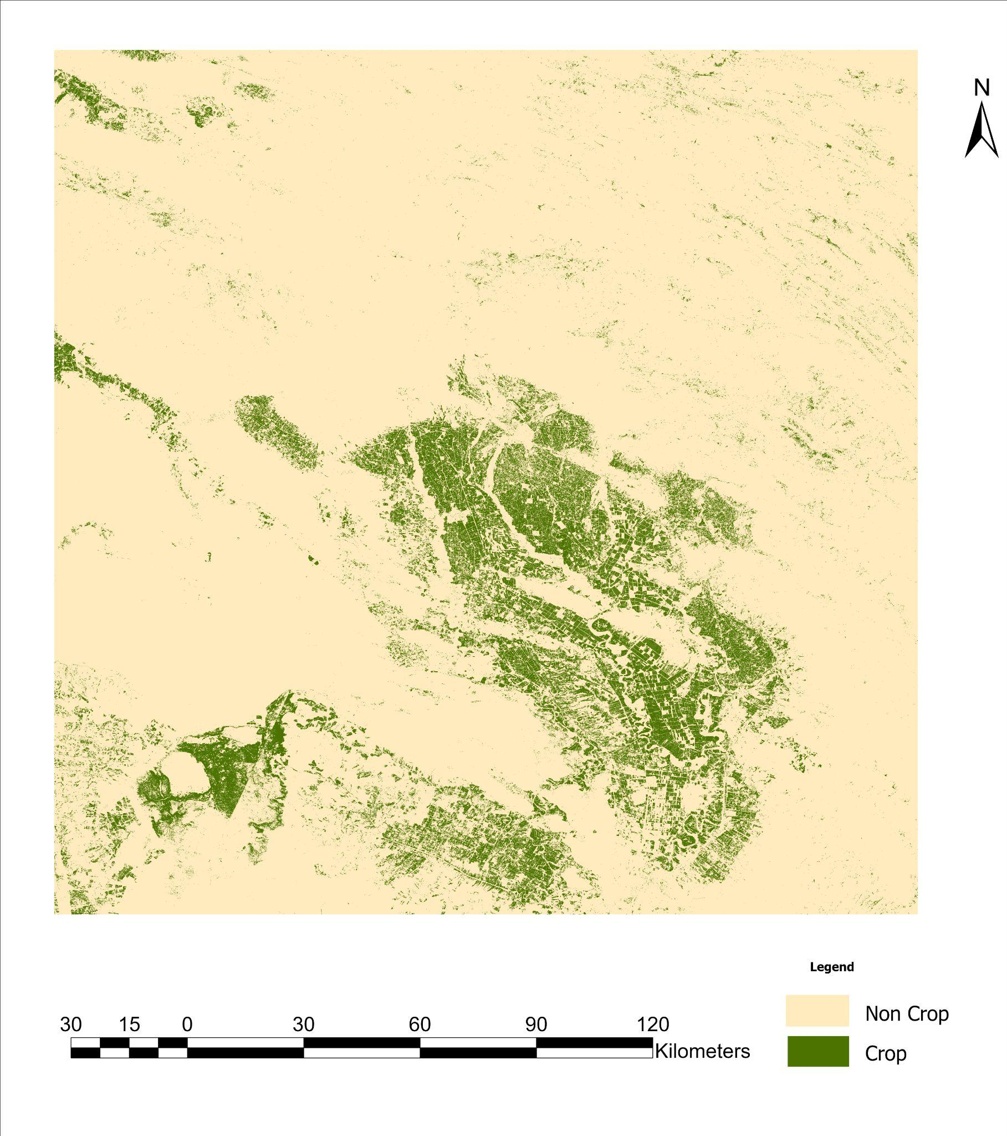
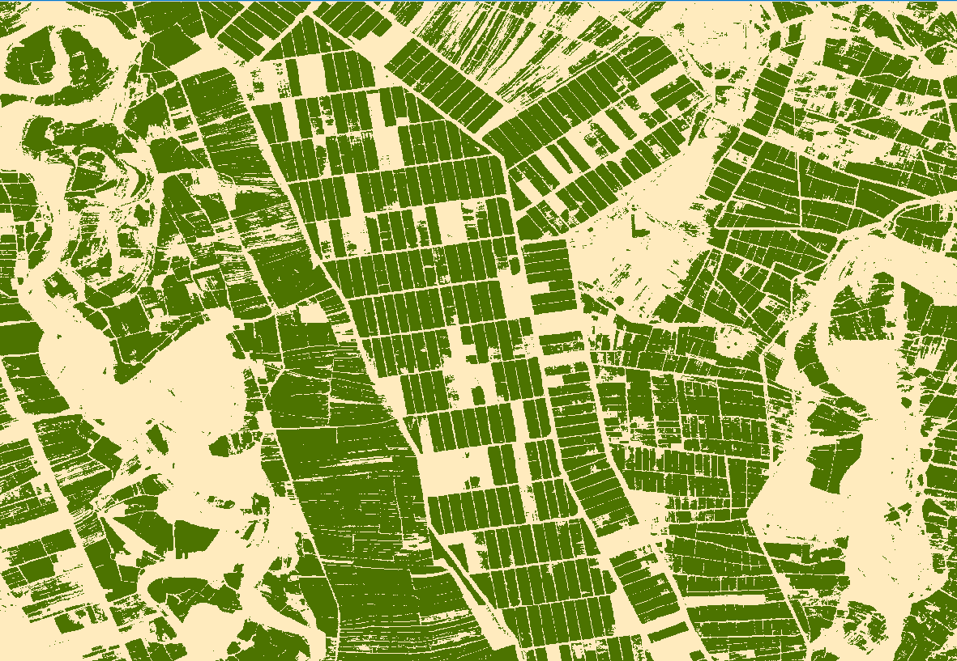
Spatial Extent - Iran

Slide 12
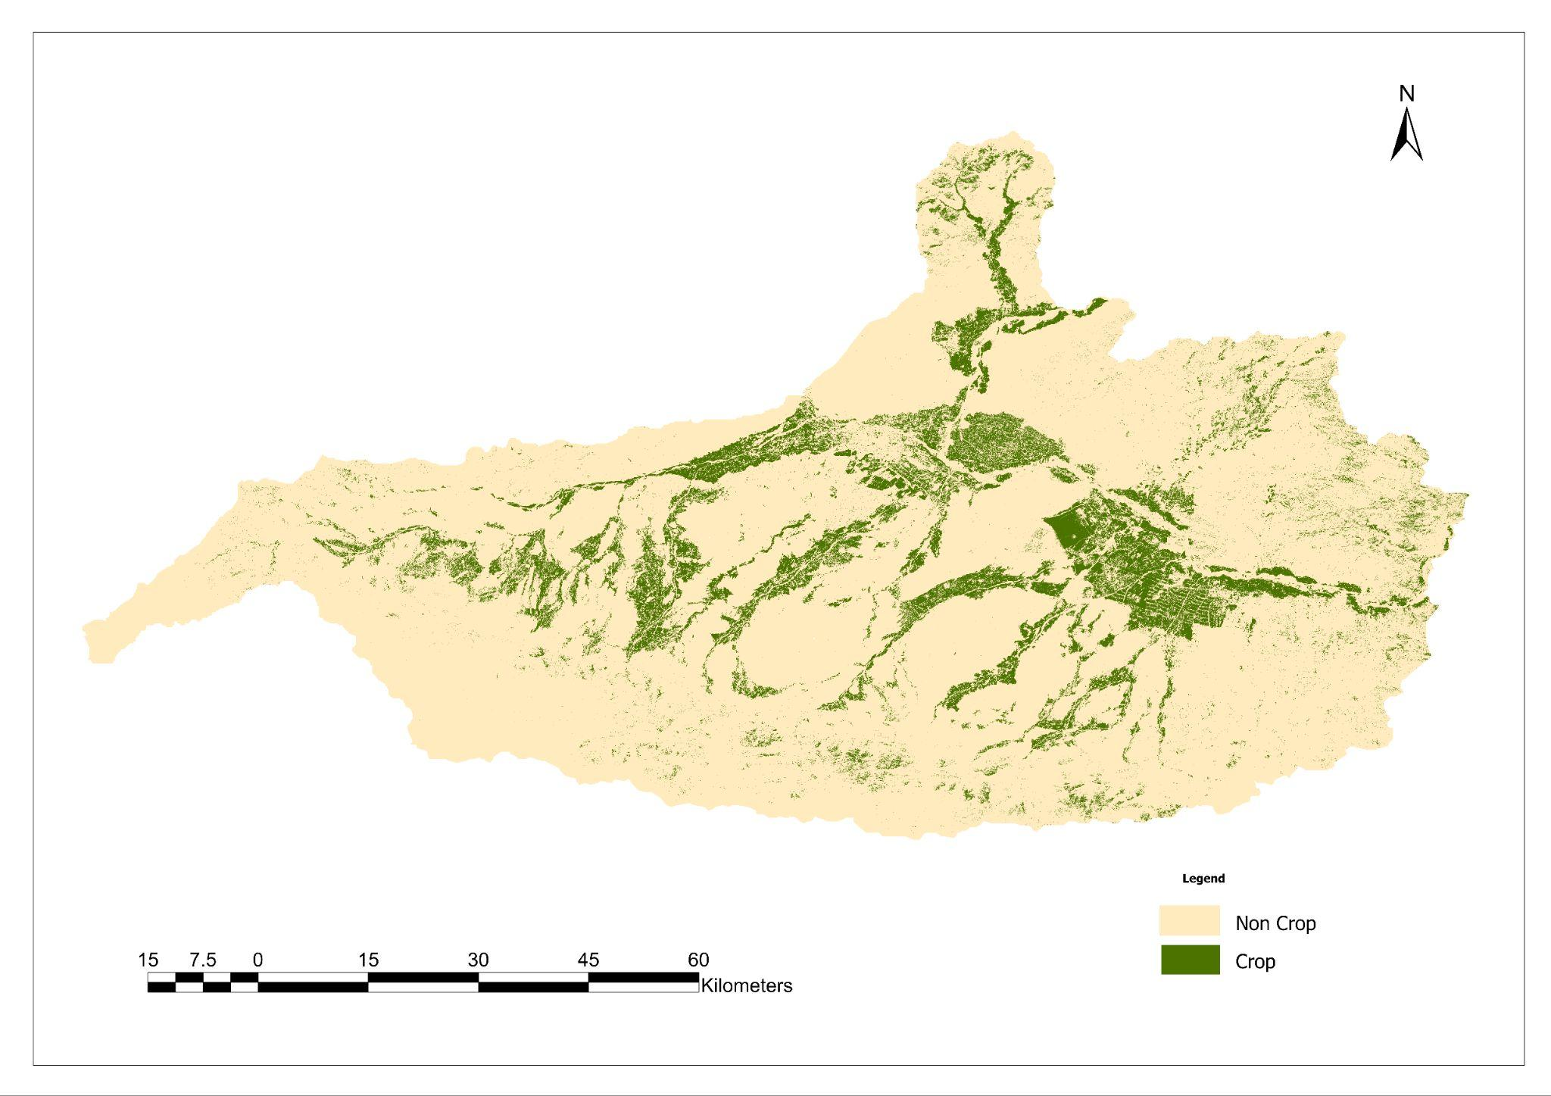
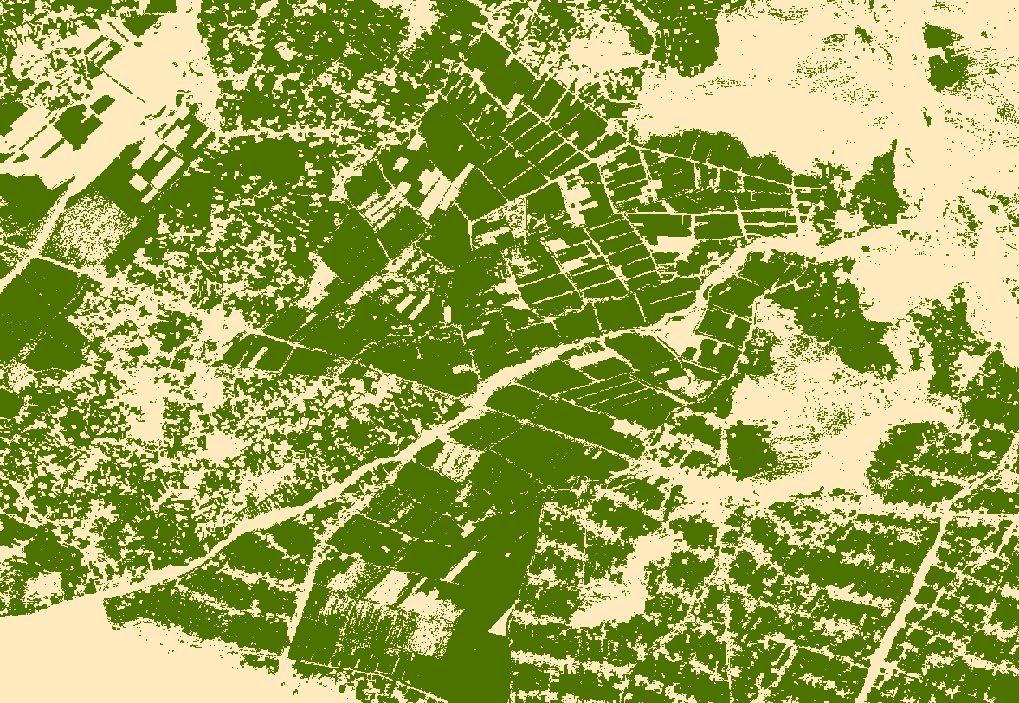
Spatial Extent - Afghanistan

